Slide 1
Single Cell Sequencing
CSHL Course: Advanced Sequencing Technologies &Applications
November 2020
Jon Preall
Research Assistant Professor
Cold Spring Harbor Laboratory

Slide 2
Why Sequence Single Cells?
Let’s do bulk RNA-seq…
Heterogeneity is EVERYWHERE

Slide 3
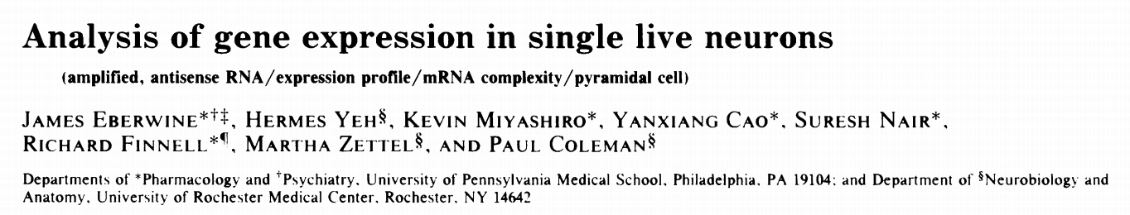
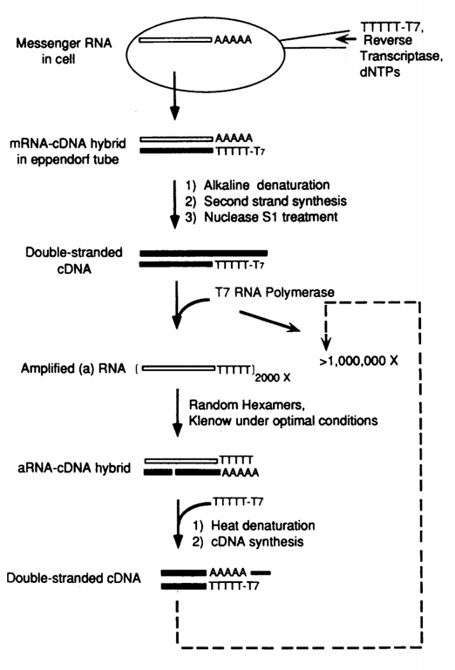
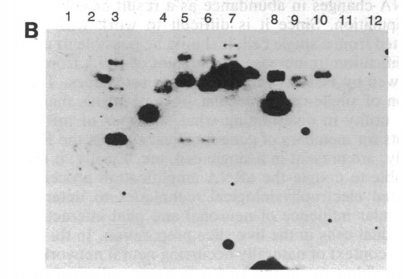
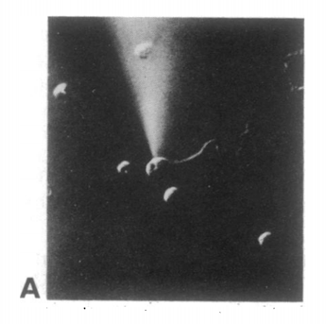
Microinjection of cDNA synthesis reagents directly into single neurons
Southern Blot
Plasmid standards containing gene of interest
Probed with aRNA
1992

Slide 4
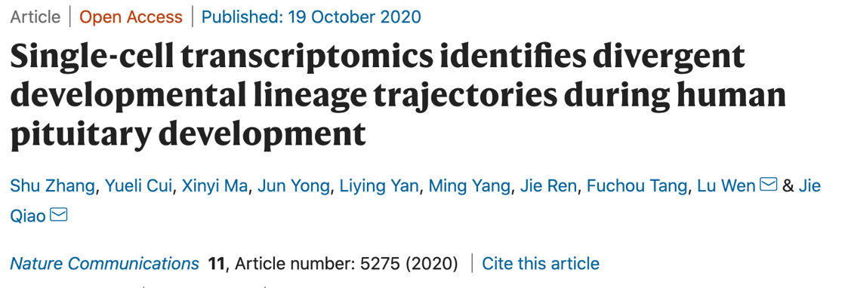
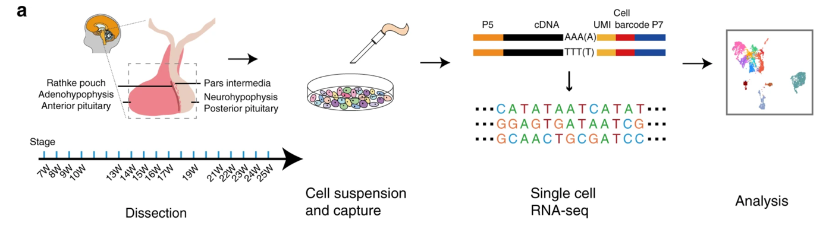
Plate-based STRT-seq
4,113 mouth-pipetted cells!

Slide 5
The Rapid Rise of Single Cell Biology
~10-fold increase in # of cells profiled every other year

Slide 6
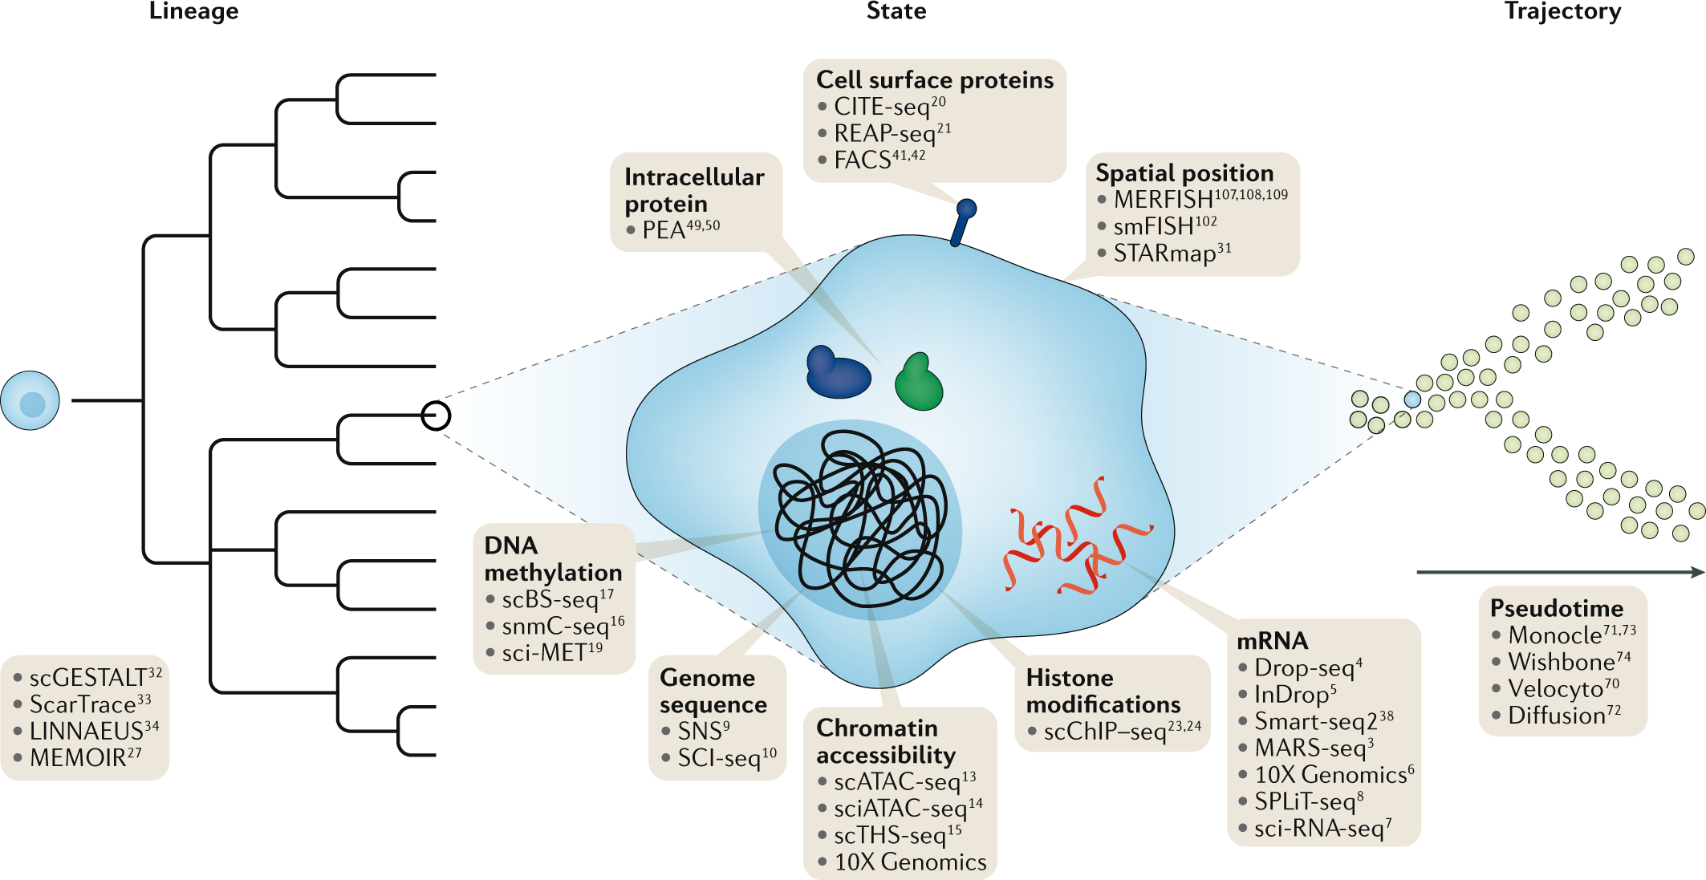
Many Flavors of Single cell ‘Omics
Stuart, T., Satija, R. Integrative single-cell analysis. Nat Rev Genet 20, 257–272 (2019). https://doi.org/10.1038/s41576-019-0093-7

Slide 7
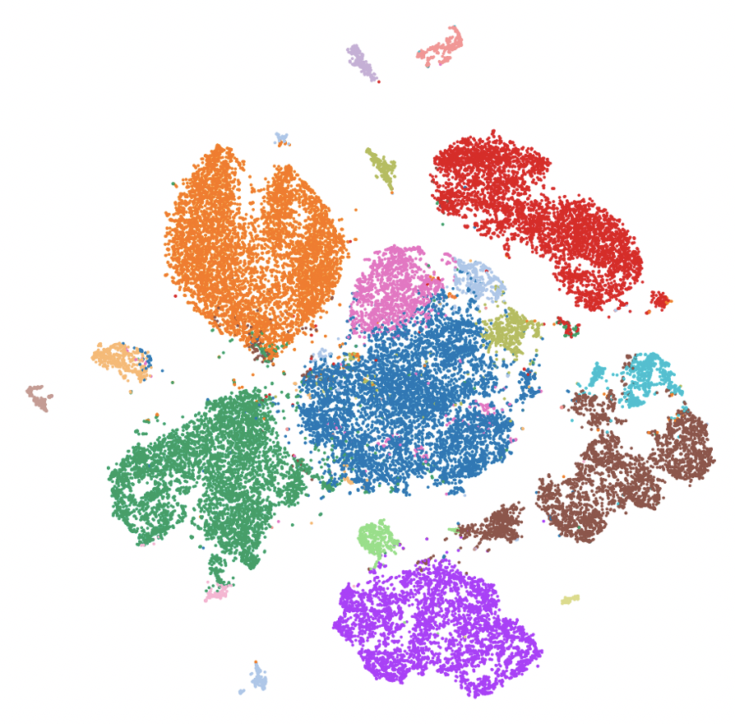
Single Cell Transcriptomics

Slide 8
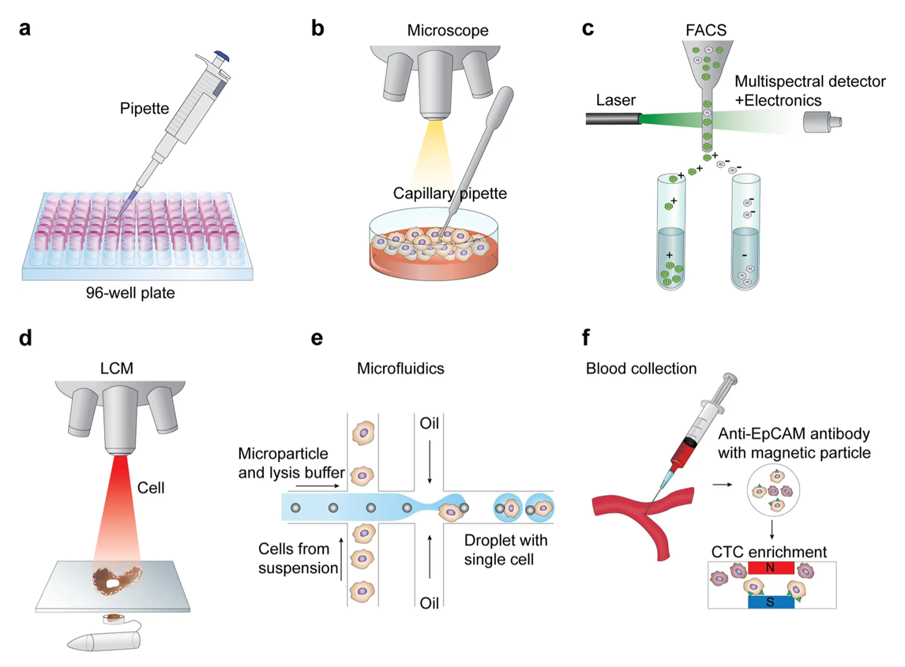
Step 1: Partitioning Cells
Hwang et al. Ex Mol Med 50,(2018)

Slide 9
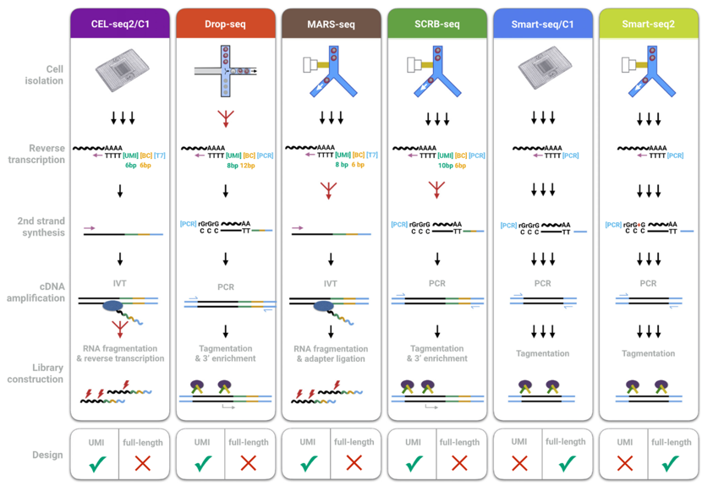
Step 2: Library Preparation
What question are you asking?
Simple Gene expression?
Strand-selective?
Alternative splicing / polyA / TSS?
Allele-specific expression?
Genotype heterogeneity (eg. in cancer)?
Depth vs Breadth?
Ziegenhain et all. Mol Cell 65:4, (2017), 631-643.e4

Slide 10
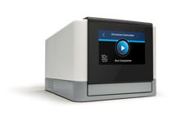
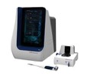
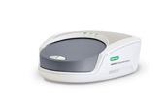
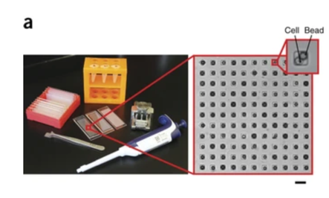
Most Common Platforms
Droplet / Bead
10X Genomics Chromium
BD Rhapsody
Bio-Rad ddSeq
Plate-based
SMART-Seq (v2, v3)
CEL-Seq2
Nanowell
Seq-Well

Slide 12
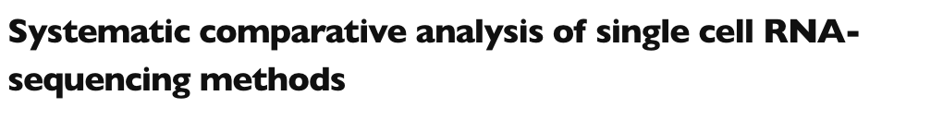
Mouse / Human cell line mixture
Ding et al. bioRxiv (2019) https://doi.org/10.1101/632216

Slide 13
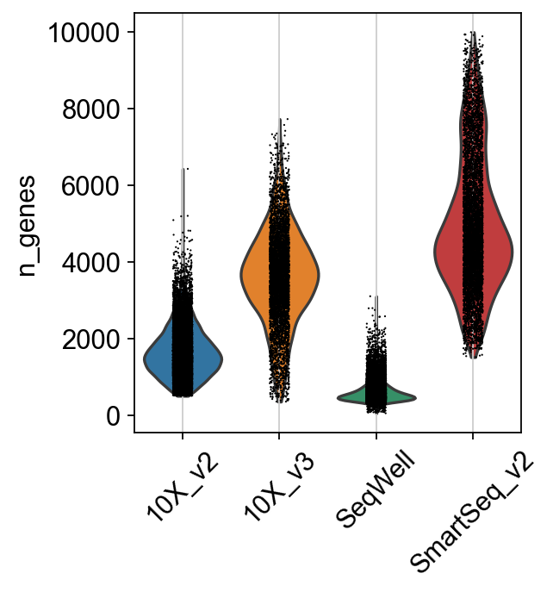
Mouse Fibroblasts:
Unique Genes Detected across technologies

Slide 14
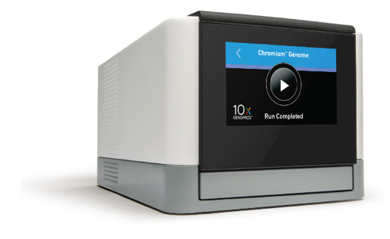
10X Genomics Platform
Chromium Controller
Hydrogel barcoded beads
Pseudo-single Poisson Loading
Partition up to 80,000 single cells per run
~10 min run time
~50% of input cells generate usable data
Partition cells up to 30um in diameter
~1% doublet rate, scales linearly w/cell #
“Lingua Franca” of single cell transcriptomics

Slide 15
10X Genomics Workflow

Slide 16
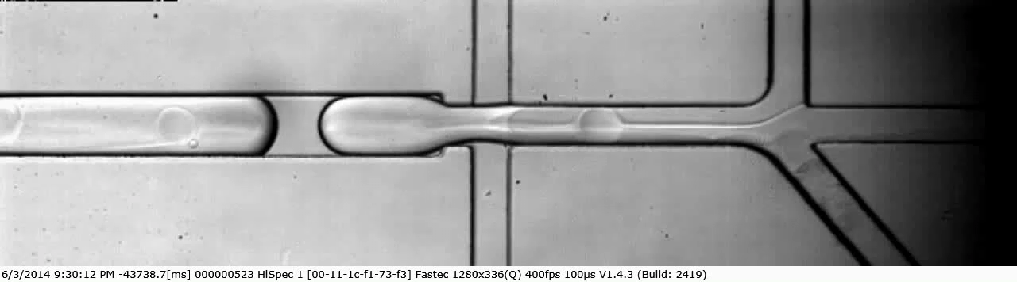

Slide 17
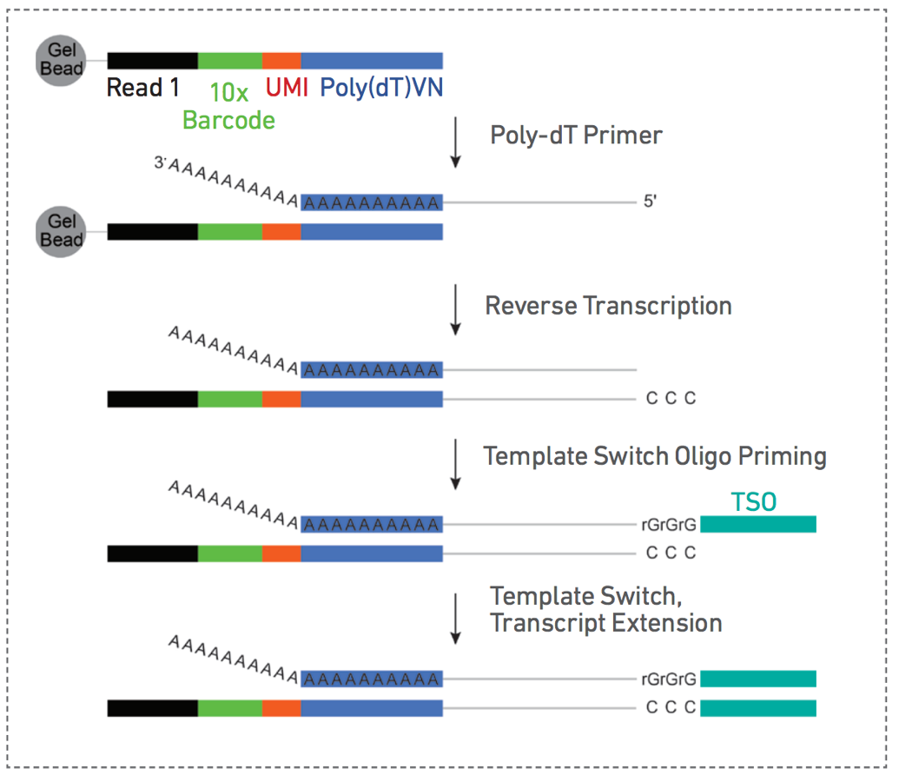
Single Cell 3’ Chemistry Overvivew

Slide 18
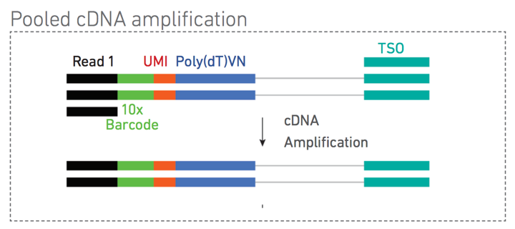
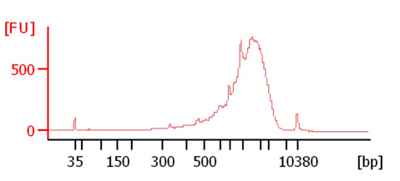
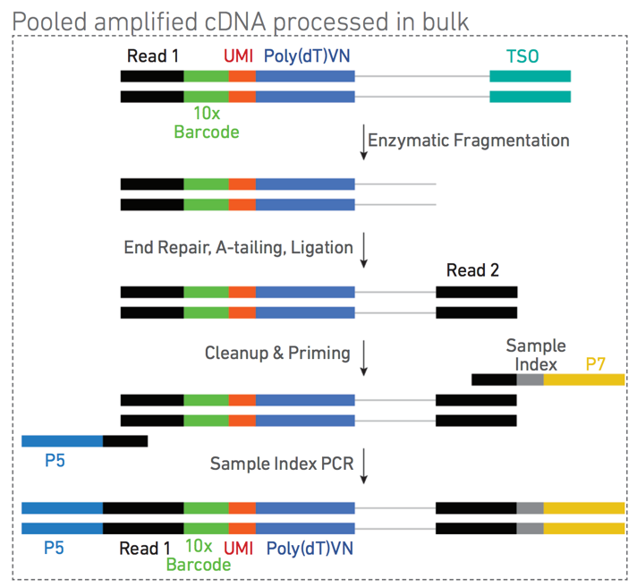
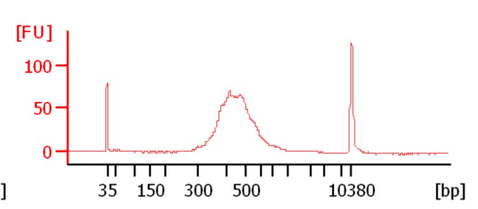
Bioanalyzer
Amplified cDNA
Final Library

Slide 19
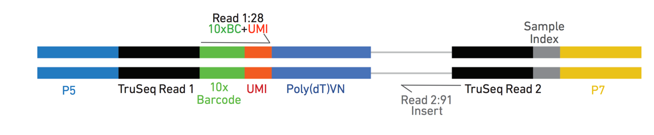
Anatomy of a 10X 3’-Single Cell Amplicon
V3 Chemistry
12bp UMI

Slide 20
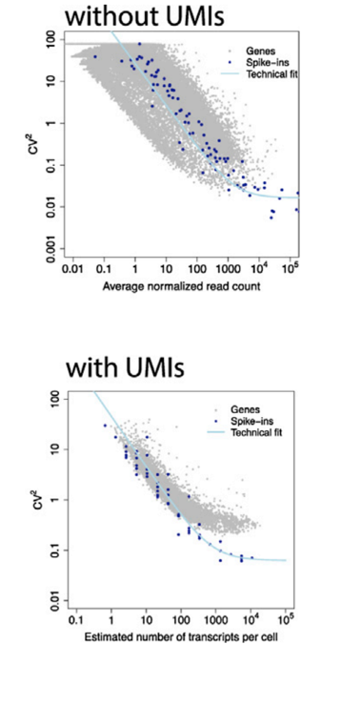
Unique Molecular Identifier (UMI)
Random ~8-10bp sequence incorporated during oligo synthesis
Cell barcode
UMI
CCCCCCCCXXXXXXTTTTTTTTTTVN
AAAAAAAAAABN---IFNgamma----
CCCCCCCCXXXXXXTTTTTTTTTTVN
AAAAAAAAAABN---IFNgamma----
CCCCCCCCXXXXXXTTTTTTTTTTVN
AAAAAAAAAABN---IFNgamma----
Before PCR
After PCR

Slide 21
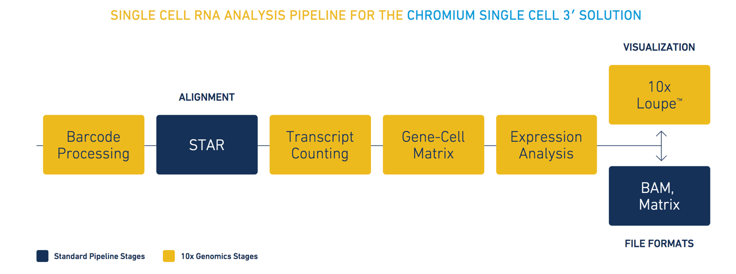
Mapping and Transcript Quantification
Cellranger Count pipeline: 10X Genomics support page

Slide 22
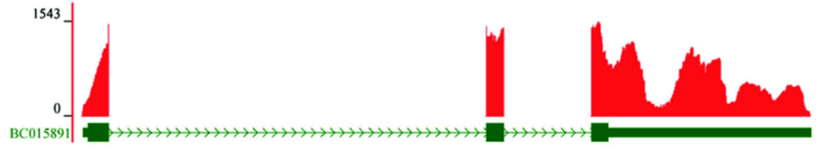
Digital Gene Expression, Not Coverage
“Deep” Single Cell Libraries
Well-based, eg. SmartSeq
Fluidigm C1
Droplet – Based DGE libraries
Drop-Seq 10X Genomics
Seq-Well

Slide 23
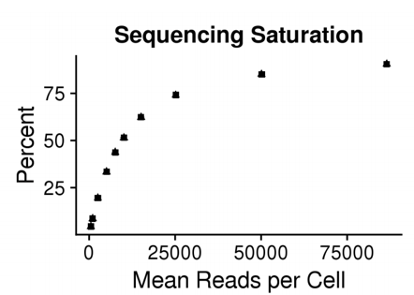
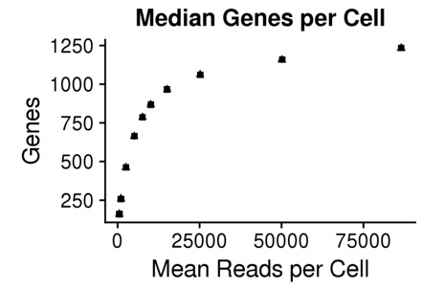
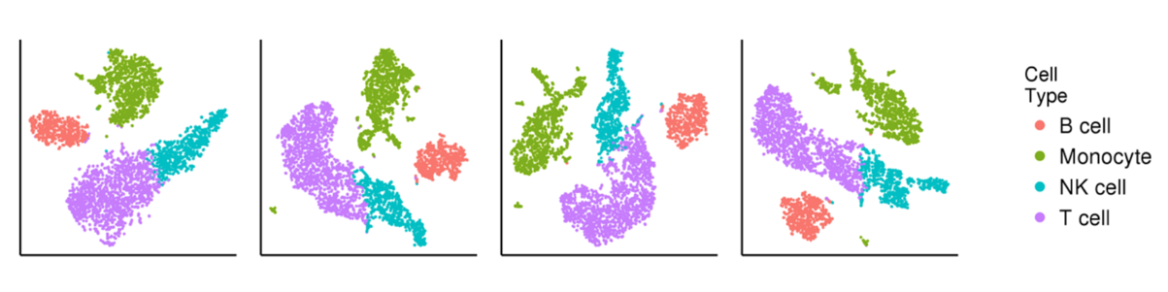
How Deeply Should I Sequence?
Human PBMC
Subsampled Library
Median
Reads / Cell
500
5,000
25,000
86,503

Slide 24
Sparse sampling of gene expression
Gene-Cell Sparse Matrix
Top | Gene Expression | US Wealth
1% | 15% | 35%
10% | 55% | 73%
20% | 73% | 86%
Genes
Cells

Slide 25
Basic output of scRNAseq pipeline

Slide 26
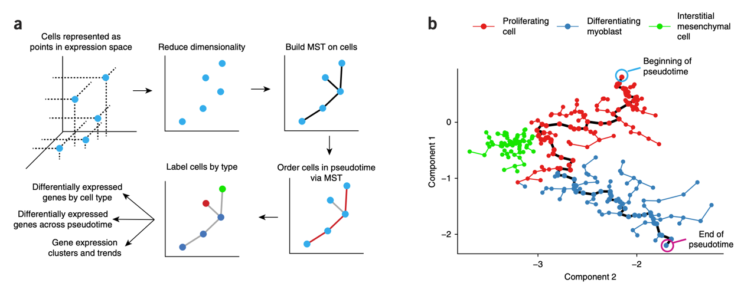
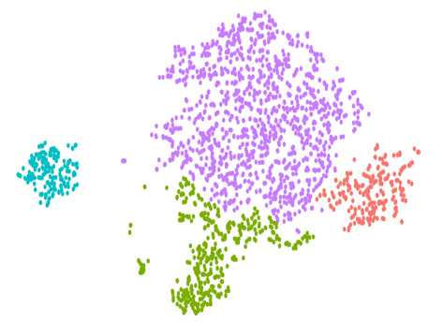
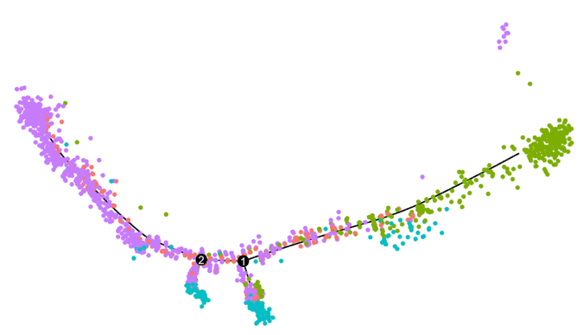
Pseudotime analysis
Monocle
https://cole-trapnell-lab.github.io/monocle3/docs/installation/

Slide 27
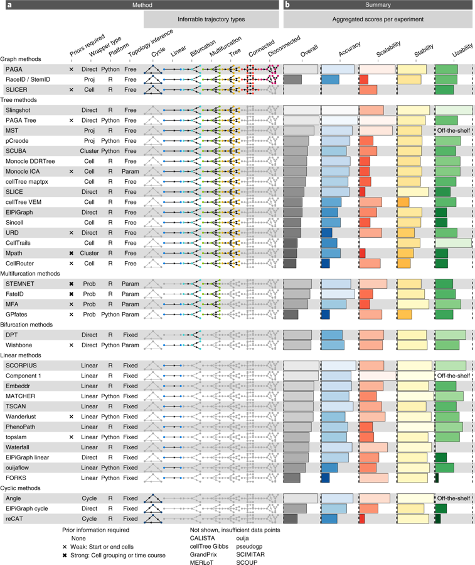
Pseudotime
Dozens of methods developed
Vary in terms of feature selection, dimensionality reduction, tree construction, etc
Saelens, W., Cannoodt, R., Todorov, H. et al. A comparison of single-cell trajectory inference methods. Nat Biotechnol 37, 547–554 (2019). https://doi.org/10.1038/s41587-019-0071-9

Slide 28
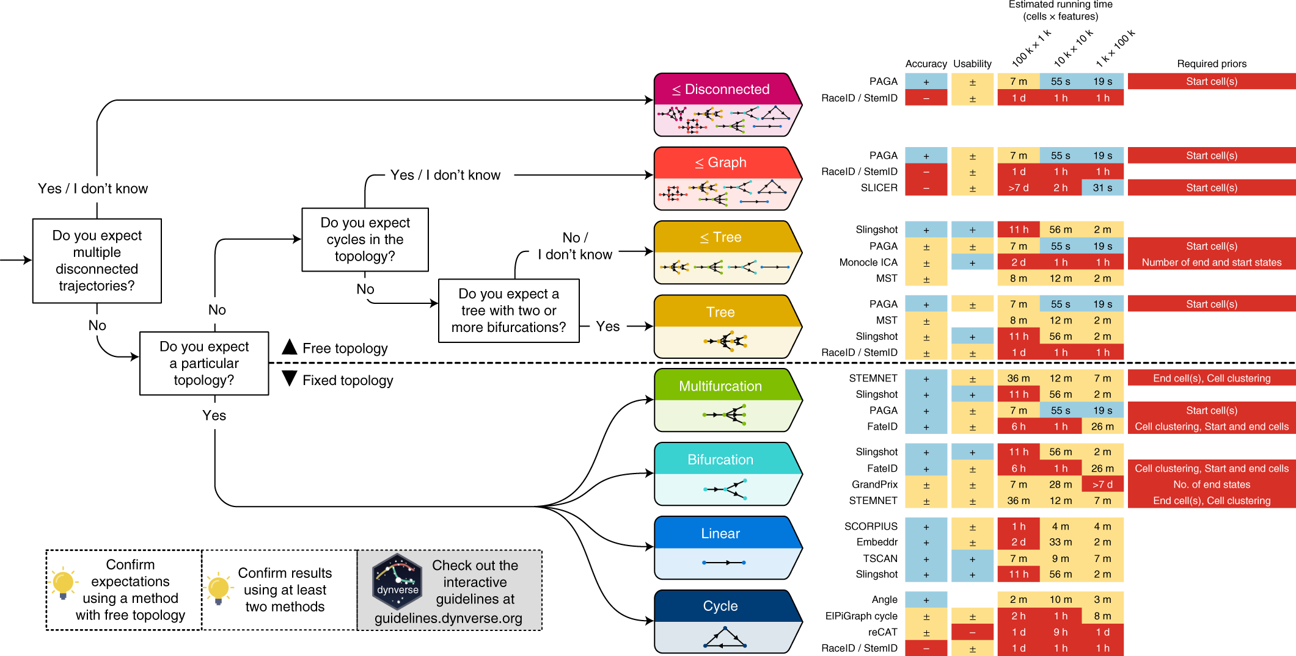
Pseudotime – which method to use?
Saelens, W., Cannoodt, R., Todorov, H. et al. A comparison of single-cell trajectory inference methods. Nat Biotechnol 37, 547–554 (2019). https://doi.org/10.1038/s41587-019-0071-9

Slide 29
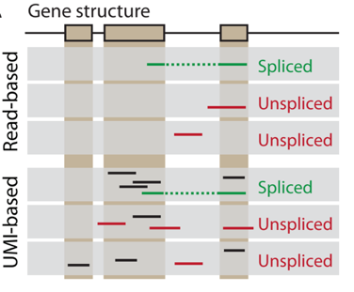
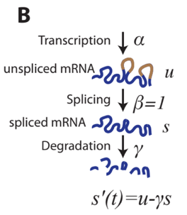
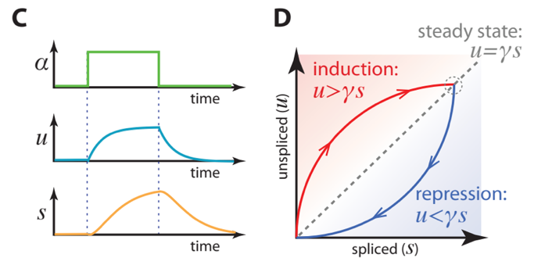
RNA Velocity
Estimates rates of change in mRNA levels by modeling nascent RNA synthesis
Quantifies spliced / unspliced
Models dynamics
CAVEATS: Gene annotations
Cryptic exons
unannotated intronic genes
repetitive elements
Le Manno et al. (2018) Nature

Slide 30
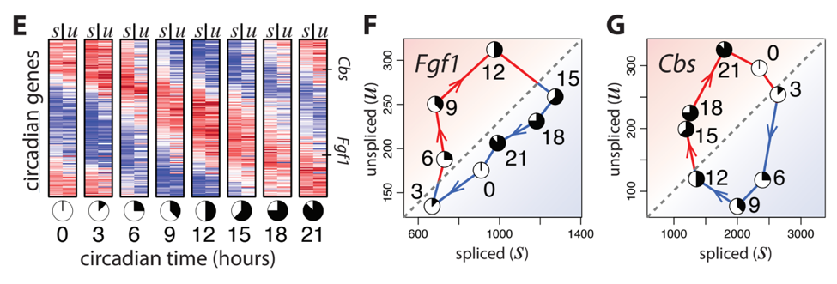
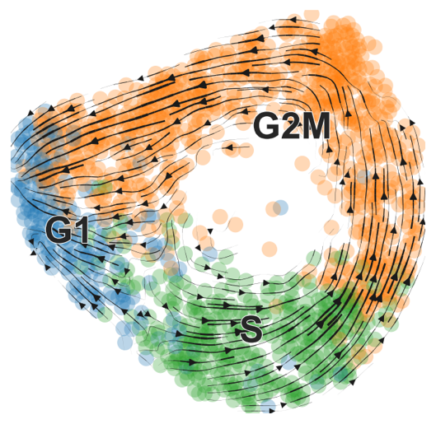
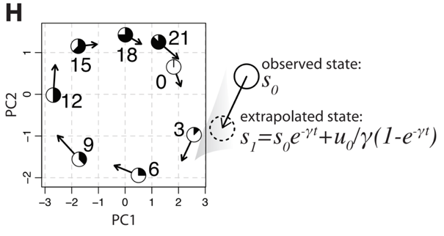
RNA Velocity
Bulk RNAseq from mouse circadian rhythm data

Slide 31
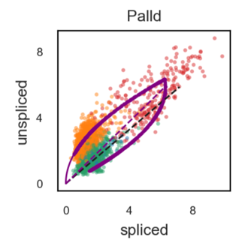
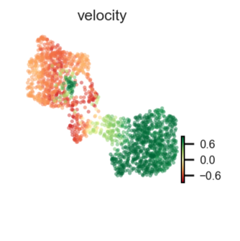
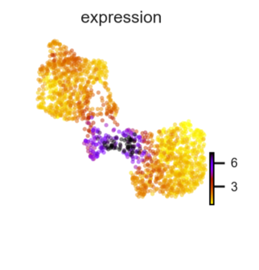
Inferring Differentiation Trajectories from RNA Velocity
Inflammatory
Fibroblasts
Resting Fibroblasts
Antigen Presenting Fibroblasts
Myofibroblasts

Slide 32
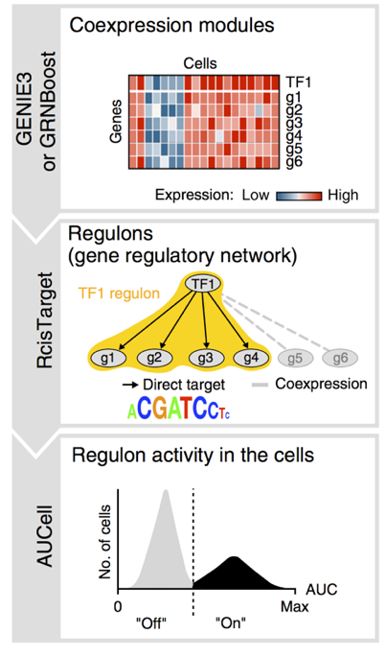
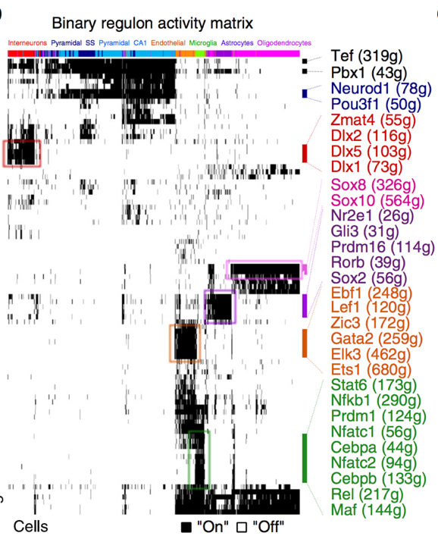
SCENIC
single-cell regulatory network inference and clustering
Transcription Factor Activity Inference
Gene Co-expression network
Motif search
Regulon activity
Aibar et al. (2017) Nature Methods. SCENIC: single-cell regulatory network inference and clustering

Slide 33
scRNAseq is a poor cytometry tool
Unreliable – highly sensitive to conditions
Expensive
Low throughput
Treat_1
Treat_2
Treat_3

Slide 34
Blind Spots
Some cell types might be missed
Low mRNA count – filtered from matrix
Early 10X Genomics Software (v2)
Defaulted to exclude lots of lymphocytes
Hard to dissociate from tissue
Fibroblasts
Cells might die quickly during prep
Stem cells
Fragile: (Acinar cells, Plasma cells)
High RNAse / protease content (Acinar, Neutrophils)
Peripheral blood neutrophils especially!!!
Doublets / Multiplets

Slide 35
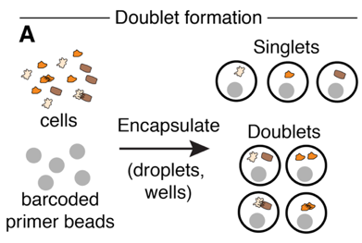
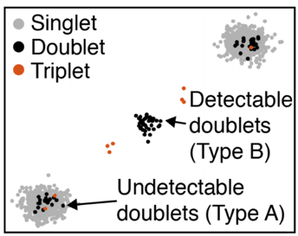
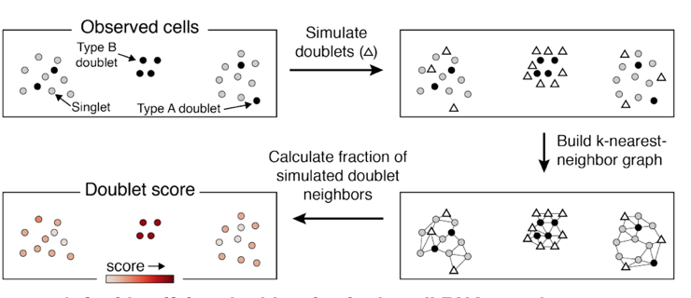
Doublets
Proportional to concentration of cell suspension
Bead
Cell 2
Scrublet
Cell 1
DoubletFinder - [R] - Doublet detection in single-cell RNA sequencing data using artificial nearest neighbors. BioRxiv
DoubletDecon - [R] - Cell-State Aware Removal of Single-Cell RNA-Seq Doublets. [BioRxiv](DoubletDecon: Cell-State Aware Removal of Single-Cell RNA-Seq Doublets)
DoubletDetection - [R, Python] - A Python3 package to detect doublets (technical errors) in single-cell RNA-seq count matrices. An R implementation is in development.
Scrublet - [Python] - Computational identification of cell doublets in single-cell transcriptomic data. BioRxiv
Wolock et al. (2018) bioRxiv

Slide 36
Sources of Measurement Noise
Library Depth
Cell Viability
Dissociation Artifacts
Cycling Cells

Slide 37
Batch effects and study design

Slide 38
Multiplexing Using Natural Genetic Variation
Demuxlet
Jimmie Ye lab

Slide 39
Sex – matched studies are helpful!
Control
Treatment
Major confounder: Male / Female
Treatment: Female Control: Male
Consequence:
Unsupervised differential gene expression calling will be dominated by sex-specific expression. No way of separating this variable from the treatment variable

Slide 40
Batch Correction
Ctrl
KO
Ctrl
KO
Myeloid
B cells
Ctrl
KO
Ctrl
KO
Confounded Study Example:
WT and KO mice
Prepared on same day
Same colony
Same set of hands
Diffex dominated by same genes within every cluster
! major batch effect issues
Ctrl
KO
Ctrl
KO
Epitheilal
T cell
Ctrl
KO
Ctrl
KO

Slide 41
Controlling for batch effects
WT
KO
Ambient RNA in droplets
Significant sources of
contaminating mRNA:
Differential expression between ”empty” droplets:
 | Erythrocytes
WT: | Epithelial
 | Granulocytes
KO: | Acinar cells
Ctrl
KO

Slide 42
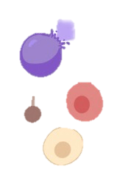

Ambient RNA: ”SOUP”
Droplet # 1 2 3 4
Cell
Lysis
Emulsion
Soup →
Read counts
Proportion of droplet reads

Slide 43

SoupX
Young and Behati (bioRxiv) 2018.
https://www.biorxiv.org/content/10.1101/303727v1

Slide 44





Getting started with your own analyses
Rahul Satija - NYGC
R
https://satijalab.org/seurat/
Fabian Theis - München
R
Liger
R
https://scanpy.readthedocs.io/en/latest/
Python
Macosko lab
Cole Trapnell –WashU
AWESOME SINGLE CELL RESOURCE
https://github.com/seandavi/awesome-single-cell

Slide 45

Loupe Cell Browser
Can:
Quickly visualize genes
Do guided clustering via marker genes / tSNE selections
Calculate Differential Expression
Export cells and gene sets for reanalysis on Cellranger (cluster)
Can’t
Redo unsupervised clustering / tSNE / UMAP
Repeat PCA / gene set selection
Pseudotime, other fancy things
https://support.10xgenomics.com/single-cell-gene-expression/software/downloads/latest

Slide 46



The Best Site On the Internet. Probably.
https://github.com/Teichlab/scg_lib_structs
Detailed visual guides to dozens of single-cell genomics methods
“What I cannot create, I do not understand.” --Feynman

Slide 47


Hacking Droplets

Slide 48

scifi-RNA-seq
Combinatorial fluidic indexing
Massive improvement in # cells
Up-front barcoding in plates via RT
Swaps chemistry of 10X Genomics:
Uses 10X Gel beads
Ligation instead of RT
Up to 150,000 cells per channel
(15X increase)
Paul Datlinger, André F Rendeiro, Thorina Boenke, Thomas Krausgruber, Daniele Barreca, Christoph Bock
doi: https://doi.org/10.1101/2019.12.17.879304

Slide 49


Genotyping of Transcriptomes
Nam et al. Nature 571, 355–360(2019)

Slide 50

CITE-Seq / REAP-Seq
Antibody Derived Tag (ADT)
sequenced as part of normal 10X run
Enables:
Simultaneous mRNA + Protein Abundance
Increased sensitivity to individual targets
‘Superloading’
Stoeckius et al.

Slide 51

CITE-Seq / REAP-Seq

Slide 52

Multiplexing with ADTs: “Cell Hashing”
Sort multiple bins → HTO Label → Repool & Capture
Stoeckius, NYGC

Slide 53


DART-seq
Droplet-Assisted RNA Targeting by single-cell sequencing
Modification of barcoded bead to prime non-poly(A) transcripts
Ligate gene-specific primers to subset of oligo-dT sites via bridge oligo
Careful titration of primers necessary
Saikia, M., Burnham, P., Keshavjee, S.H. et al. Simultaneous multiplexed amplicon sequencing and transcriptome profiling in single cells. Nat Methods 16, 59–62 (2019). https://doi.org/10.1038/s41592-018-0259-9

Slide 54

Perturb-Seq
Adamson et al. (2016). Cell 16(7), 1867–1882.e21

Slide 55


mRNA
Antibody tags
Cas9 tracrRNA
Multiple RT primer sequences per bead
High efficiency capture of antibody tags, CRISPR guides

Slide 56
TCR/BCR Profiling
CDR3
“interesting part”
Reads from 3’ droplet-based scRNAseq
V
D
J
C

Slide 57

5’-Barcoded Libraries
NVTTTTTTTTT-Adapter
CDR3
AAAAAAAAAAAAAAAA
Vβ
Dβ
Jβ
Cβ
TCRβ
----TSO-rG-rG-rG
~900bp
R1-Barcode-UMI
Problem: standard transcriptome libraries have strong 3’-bias
CDR3 mapping requires 5’-Barcoded library
Random fragmentation to sample different 3’-ends of reads
Require much longer reads (300bp) at a depth of 5,000X / cell

Slide 58





10X VDJ output example
Individual V / J usage
Pairwise V-J usage
TRA
TRB
TRA
TRB
Independent T-cells
Example Rearranged
TCR beta chain

Slide 59



Slide 60

Rapid Filter for Neutralizing antibody candidates:
VDJ sequencing:
Select only IgG1 isotypes
Clones with multiple observed cells
Clones with somatic hypermutation
Gene expression analysis
Exclude exhausted and naïve phenotypes
Favor memory and plasma phenotypes

Slide 61
Other high-throughput platforms

Slide 62

Combinatorial Indexing Split-Seq
U. Washington
Seelig Lab

Slide 63
Combinatorial Indexing sci-Seq
U. Washington
Shendure Lab

Slide 64



Combinatorial Scaling
Round 1
Round 2
96 x 96 = 9,216 ÷ 10 = ~921 cells
96 x 384 = 36,864 ÷ 10 = ~3,684 cells
384 x 384 = 147,456 ÷ 10 = 14,746 cells
To avoid random sampling of same barcode combinations, use ~10% of total theoretical combinations as input
Enormously scalable
Can achieve <$0.01 per cell
Labor intensive
Significant ‘boot-up’ cost
Significant validation cost
Who can afford that much sequencing, anyway?

Slide 65



Mouse embryonic development
sci-RNA-seq3
2,058,652 single-cell transcriptomes

Slide 66

Seq-Well
PDMS array of ∼86,000 subnanoliter wells
Sized to fit 1 bead per well
Drop-Seq style barcoded beads
Sealed chamber for each cell
Gierahn et al. Nature Methods 14, 395–398 (2017)

Slide 67



400,000 single cells from
major mouse organs

Slide 68

Array-based formats
Cell / reagent arrayers
Eg. Scienion sciFlexarray
Scienion cellenONE
Custom workflows
Imaging-based sorting / rejection

Slide 69
dna
The Other Nucleic Acid

Slide 70


10X Genomics Single Cell ATAC

Slide 71


10X Genomics Single Cell ATAC

Slide 72


Slide 73


ASAP-seq
Mimitou et al. bioRxiv (2020) t doi: https://doi.org/10.1101/2020.09.08.286914

Slide 74

sci-ATAC
Round 1:
Internally Barcoded
Tn5 transposomes
Round 2:
Barcoded PCR primers

Slide 75



SHARE-Seq
Same-cell scRNA/ATAC
Combinatorial split-pool barcoding of adapters
Ma et al. Cell. 2020 Oct 20;S0092-8674(20)31253-8. doi:10.1016/j.cell.2020.09.056.

Slide 76



SNARE-seq
Chen et al. bioRxiv (2019) doi:10.1101/692608

Slide 77



Single cell CNV
Primary Tumor
Liver Metastasis
Nick Navin, Mike Wigler
CSHL
Flow sort
Low coverage sequencing
(6% per cell)
Navin et al. Nature (2011) Apr 7; 472(7341): 90–94.

Slide 78

Droplet-based Single Cell CNV

Slide 79




Droplet-based Single Cell CNV
Deproteinized, lysed cell
w/DNA trapped in bead
Barcoded
Gel Beads

Slide 80



Slide 81


Mission Bio Tapestri
DNA-focused microfluidic platform
For SNV & CNV

Slide 82



Mission Bio Tapestri

Slide 83
Other Omics

Slide 84

sci-MET
Mulqueen et al. Nat Biotechnol. 2018 Jun;36(5):428-431

Slide 85
CoBATCH
Transcription factor binding sites in single cells
Wang et al Mol Cell (2019) 76:1, p206-216.e7

Slide 86

CoBATCH

Slide 87

Single cell itChIP
Ai et al. Nat Cell Biol (2019) 21, p1164–1172

Slide 88
Sequencing Costs
 | RNA-seq | ATAC-seq | CNV
Reads per Cell | 50-100k | 50-100k | 750k+
Cells per Experiment | 2,000 – 10,000 | 2,000 – 10,000 | 1,000-2,000
Sequencing Platform Min. | NextSeq HO | NextSeq HO | NovaSeq S1
Cost per Experiment | ~$2,500 | ~$2,800 | $12,000

